Slide 1
Microdata and Algorithms 1.0
CIS 4911 Fall 2017 Senior Project
Michael Garrett
Christian Molto

Slide 2
Project Motivation
-DNA microarrays or biochips are probes containing user-specified DNA sequences sent into biological samples. The probes emit light upon pairing with a corresponding DNA sequence in the sample the probe is sent to.
-Analysis of the data on these chips can reveal many things, but there is no standard microarray data format. So computer experts are often called upon to build DNA chip analysis systems, which is the role we played in this project.
-Our product is a preprocessing data filter that allows the user to search for specific keywords and exclude empty data points, among other things.

Slide 3
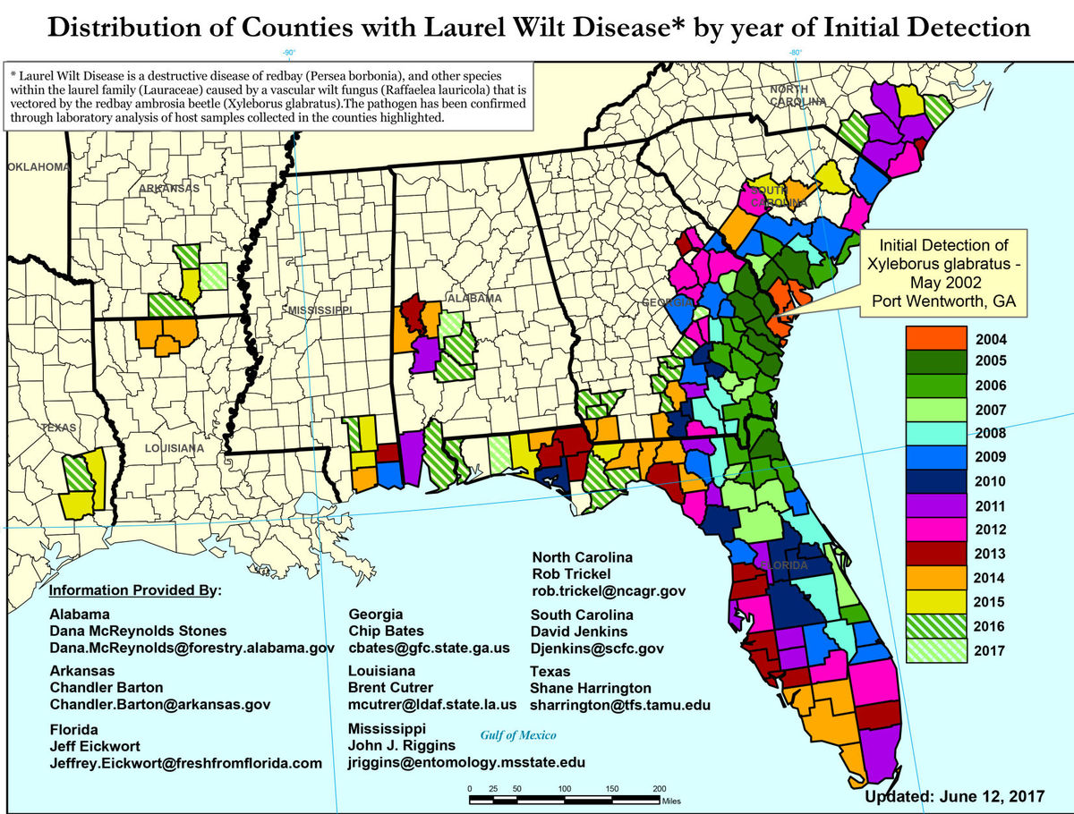
Application: laurel wilt disease
-This disease puts the multi-billion dollar avocado
industry in the Americas at risk.
-It also affects all members of the laurel family, with
a 98% fatality rate.
-The fungus that spreads the disease, Raffaelea
lauricola, can be removed with fungicide.
-Our project will be used to locate genes in
biological agents to make such a fungicide.

Slide 4
Application: cadaver time of death
-Our project is being used to locate genes that can be used as markers to determine how much time has passed since a human individual’s demise.
-Measured at a series of time intervals taken from a set of human cadavers, the genetic intensities at different stages of the natural decay process may indicate a pattern consistent across all human cadavers.
-If such a pattern exists, samples taken from a dead individual can tell what part of the decay process their corpse was at when the sample was taken.

Slide 5
Code Architecture
-Our software prioritizes performance over modularity and forgoes traditional objects and classes in favor of more efficient data structures such as arrays and hashmaps.
-Because of this, there are few diagrams to describe the architecture, and those that exist have a low degree of complexity.
-Performance:
Typical Input File: 98205 records, with 7 categories (string) and 12 data points (long) per record
Time to create output file: <3 seconds
Large Input File: 98205 records, with 7 categories (string) and 204 data points (long) per record
Time to create output file: 10-30 seconds

Slide 6
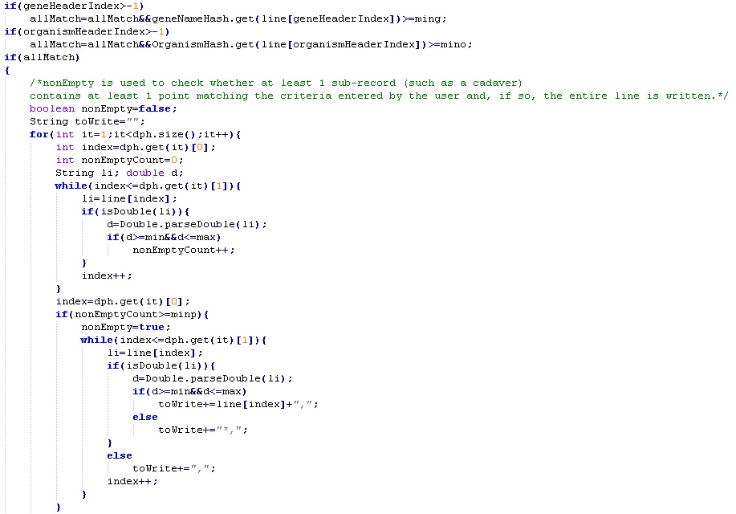
Main Code Algorithm

Slide 7
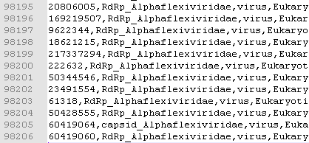
Input/Output file
-The input and output files follow the same format: A
single csv file beginning with a series of categorical
headers, then the names of each new set of data values
belonging to one biological sample marked with “#”,
followed by the data.
-It is possible for there to be >100000 records, each having several categories and hundreds of data values.
-Example header:

Slide 8
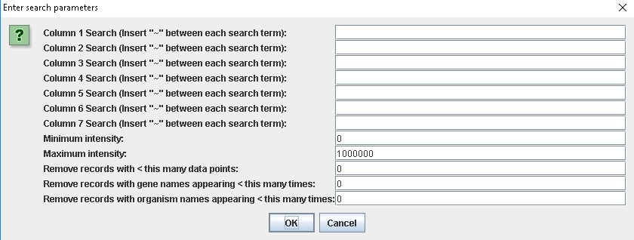
User Interface

Slide 9
User Interface
-The number of column-specific search entries is dynamically generated, based on the number of columns in the user’s input file.
-The intensity value of a gene at is associated with the radiant intensity of the probe used to identify that gene. The higher this value, the stronger the presence of the gene.
-Since there are often empty data points, an option used to specify the minimum number of non-empty data points has been included.
-See also: Wikipedia articles on gene chip analysis and DNA microarrays

Slide 10
Summary
The team created a more user friendly program for querying purposes with features for biology department and handles large datasets.
Christian Molto: chrismolto@comcast.net
Michael Garrett: magarr123@gmail.com
Questions?
Thank you!

